Slide 1
多载波MIMO信道下的波束成形设计
报告人：程家乐
日期：2019/11/11

Slide 2
Joint Tx-Rx Beamforming Design for Multicarrier MIMO Channels
Reporter：程家乐
Date：2019/11/11

Slide 3
01
01
多载波通信与OFDM
02
02
受控理论与Schur凸分析
03
03
信号传输模型
04
04
接收矩阵的优化
05
05
传输矩阵的优化
06
06
TX-RX联合优化

Slide 4

Multicarrier Communication & OFDM

Slide 5
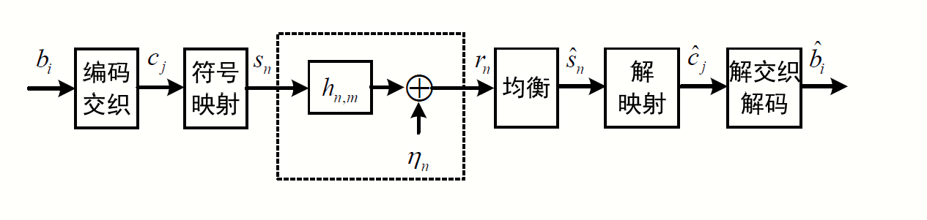
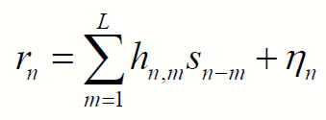
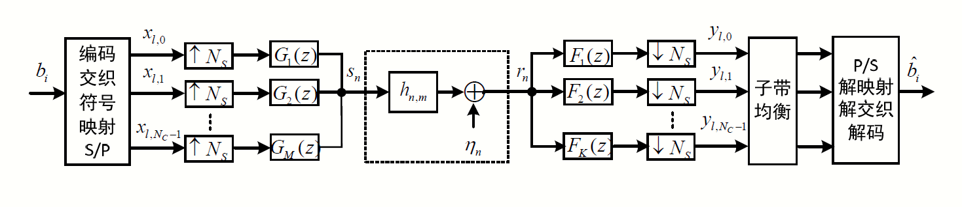
单载波传输与多载波传输
图1.1 单载波传输示意
离散时间基带等效信道
图1.2 多载波传输示意

Slide 6
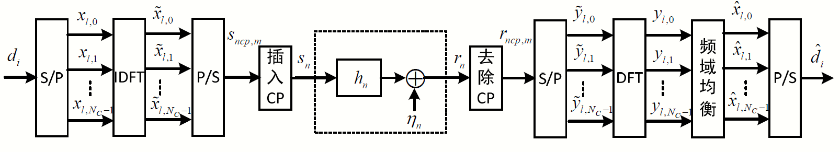
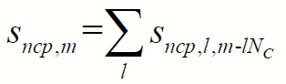
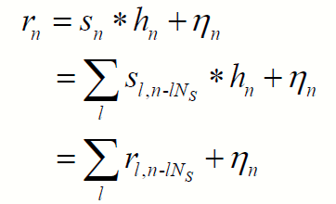
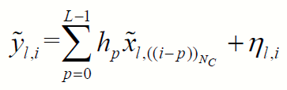
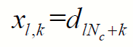
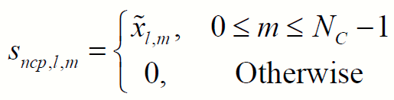
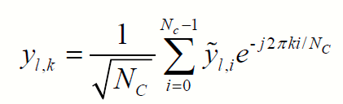
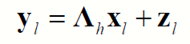
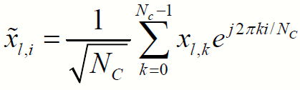
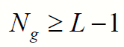
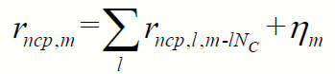
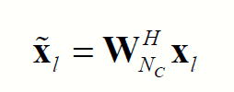
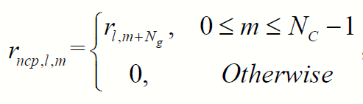
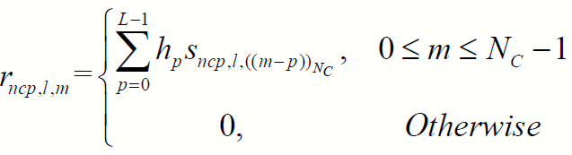
OFDM传输离散时间基带系统框图
发送端S/P：
发送端P/S：
OFDM信道：
接收端S/P：
DFT：
IDFT：
插入CP：
去除CP：

Slide 7

Majority Theory & Schur Convex Analysis

Slide 8
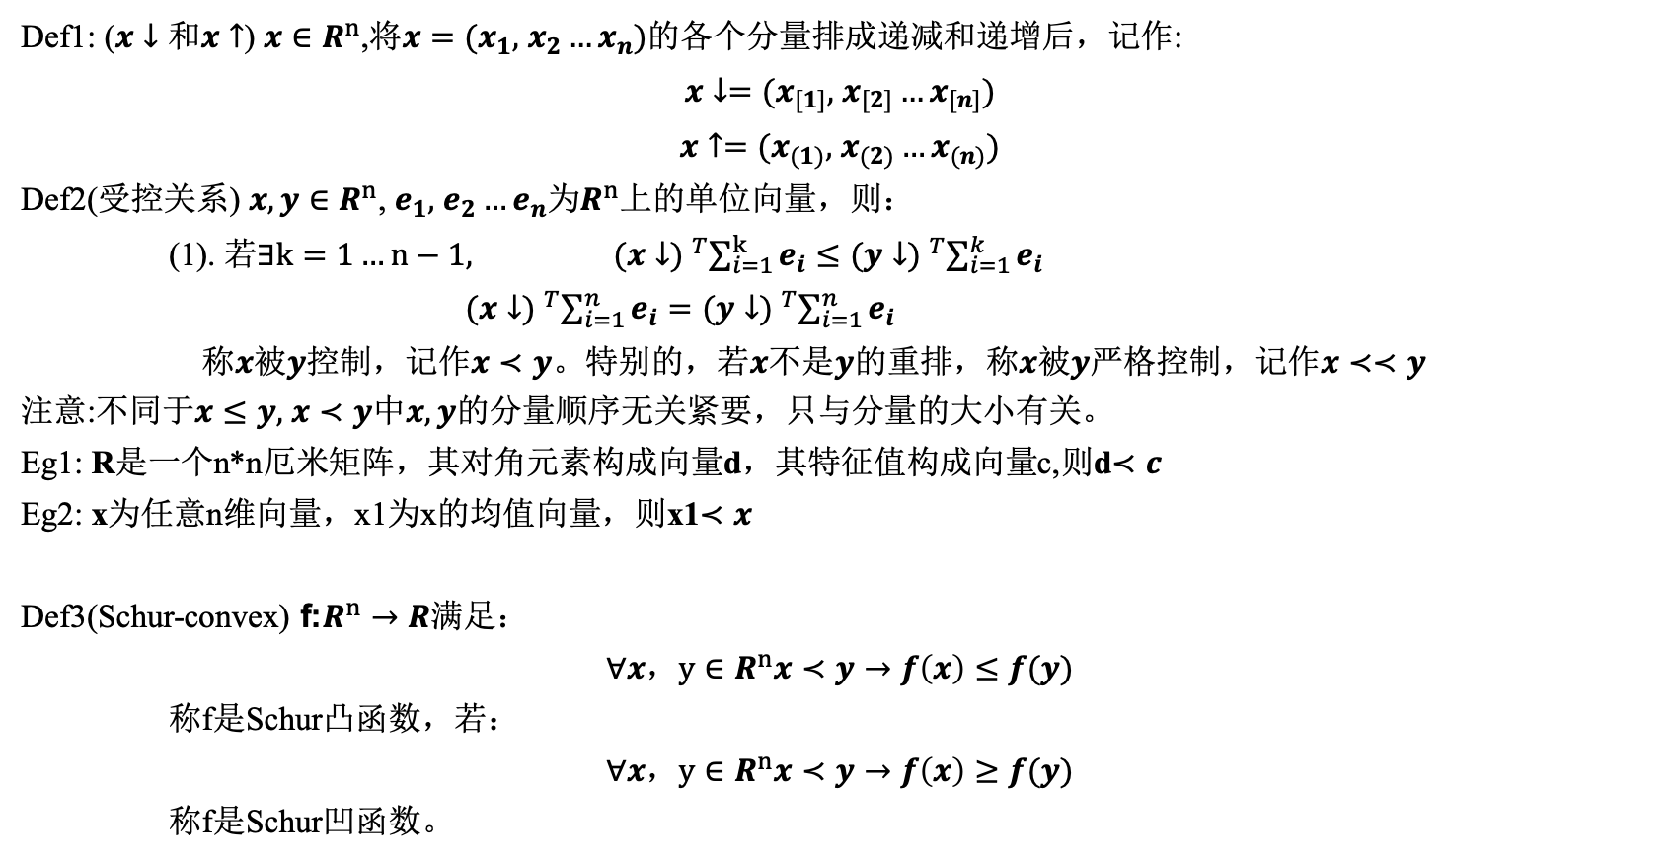
受控理论
Def1: ($x↓和x↑$) $x∈R^{n}$,将$x=(x_{1},$ $x_{2}…x_{n})$的各个分量排成递减和递增后，记作:
$x↓=(x_{[1]},$ $x_{[2]}…x_{[n]})$
$x↑=(x_{(1)},$ $x_{(2)}…x_{(n)})$
Def2(受控关系) $x,y∈R^{n}$, $e_{1},$ $e_{2}…e_{n}为R^{n}$上的单位向量，则：
(1). 若$∃k=1…n−1,$ ${(x↓) }^{T}\sum_{i=1}^{k}{e_{i}}≤{(y↓) }^{T}\sum_{i=1}^{k}{e_{i}}$
${(x↓) }^{T}\sum_{i=1}^{n}{e_{i}}={(y↓) }^{T}\sum_{i=1}^{n}{e_{i}}$
称$x被y$控制，记作$x≺y$。特别的，若$x不是y$的重排，称$x被y$严格控制，记作$x≺≺y$
注意:不同于$x≤y,$ $x≺y中x,y$的分量顺序无关紧要，只与分量的大小有关。
Eg1: R是一个n*n厄米矩阵，其对角元素构成向量d，其特征值构成向量c,则d$≺c$
Eg2: x为任意n维向量，x1为x的均值向量，则x1$≺x$
Def3(Schur-convex) f:$R^{n}→R$满足：
$$∀x，y∈R^{n}x≺y→f\left(x\right)≤f(y)$$
称f是Schur凸函数，若：
$$∀x，y∈R^{n}x≺y→f\left(x\right)≥f(y)$$
称f是Schur凹函数。

Slide 9

Signal Model
Research Methods And Processes

Slide 10
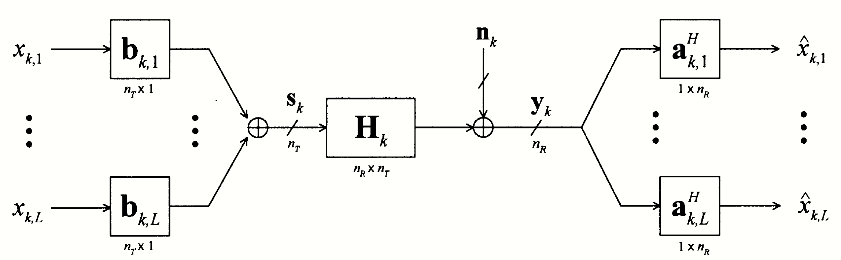
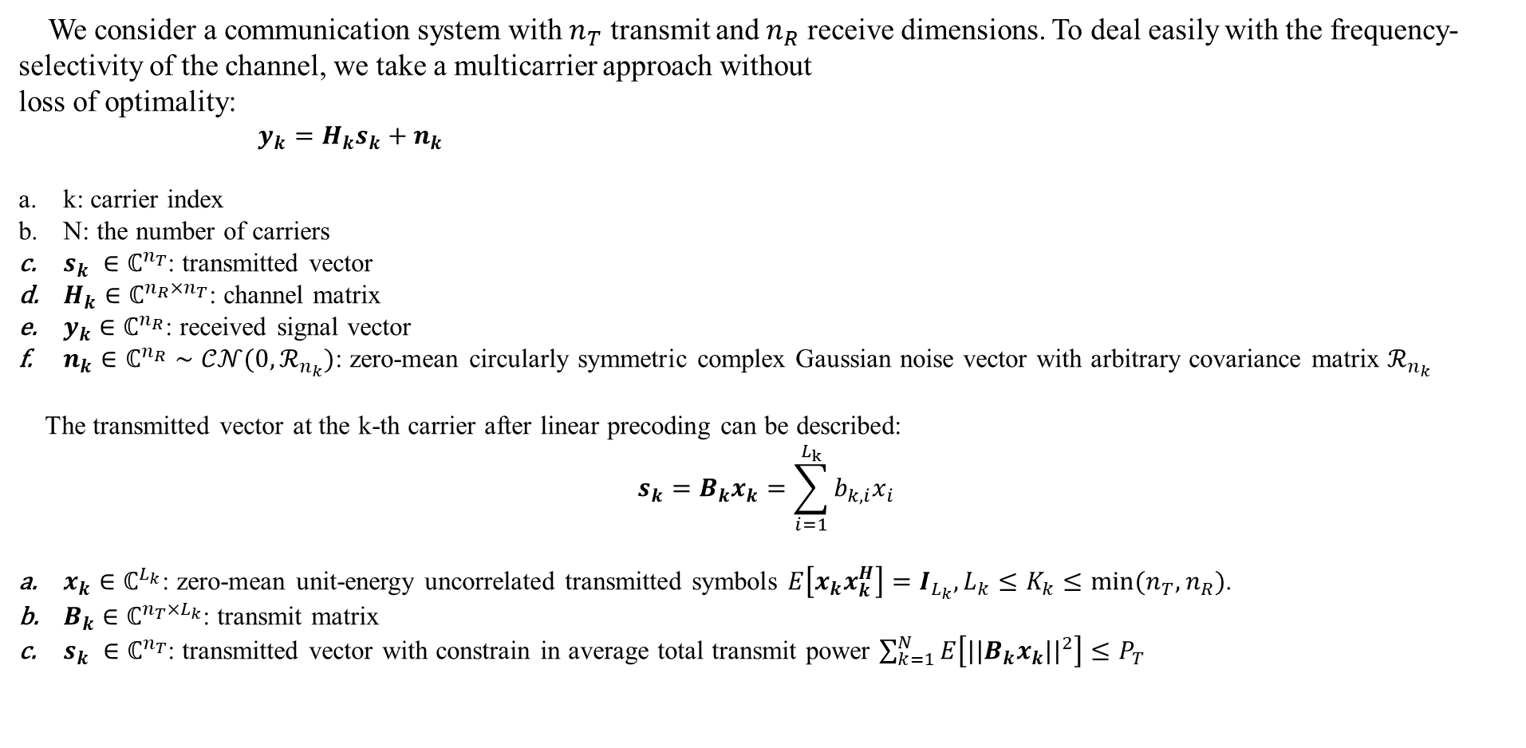
Carrier-noncooperative approach
We consider a communication system with $n_{T}$ transmit and $n_{R}$ receive dimensions. To deal easily with the frequency-selectivity of the channel, we take a multicarrier approach without
loss of optimality:
$y_{k}=H_{k}s_{k}+n_{k}$
k: carrier index
N: the number of carriers
$s_{k} ∈ℂ^{n_{T}}$: transmitted vector
$H_{k}$ $∈ℂ^{{n_{R}×n}_{T}}$: channel matrix
$y_{k}$ $∈ℂ^{n_{R}}$: received signal vector
$n_{k}$ $∈ℂ^{n_{R}}∼𝒞𝒩(0,ℛ_{n_{k}})$: zero-mean circularly symmetric complex Gaussian noise vector with arbitrary covariance matrix $ℛ_{n_{k}}$
The transmitted vector at the k-th carrier after linear precoding can be described:
$$s_{k}=B_{k}x_{k}=\sum_{i=1}^{L_{k}}{b_{k,i}x_{i}}$$
$x_{k}$ $∈ℂ^{L_{k}}$: zero-mean unit-energy uncorrelated transmitted symbols $E\left[x_{k}x_{k}^{H}\right]=I_{L_{k}},L_{k}≤K_{k}≤min⁡(n_{T},n_{R})$.
$B_{k}$ $∈ℂ^{{n_{T}×L}_{k}}$: transmit matrix
$s_{k} ∈ℂ^{n_{T}}$: transmitted vector with constrain in average total transmit power $\sum_{k=1}^{N}{E\left[{||B_{k}x_{k}||}^{2}\right]}≤P_{T}$

Slide 11
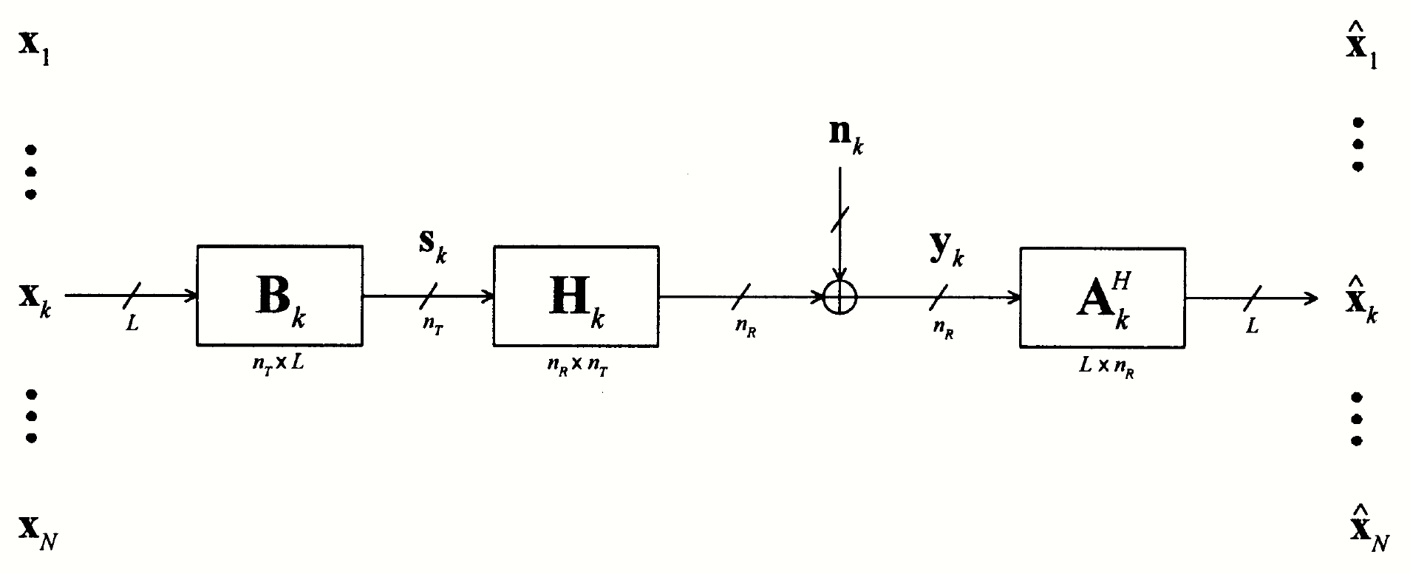
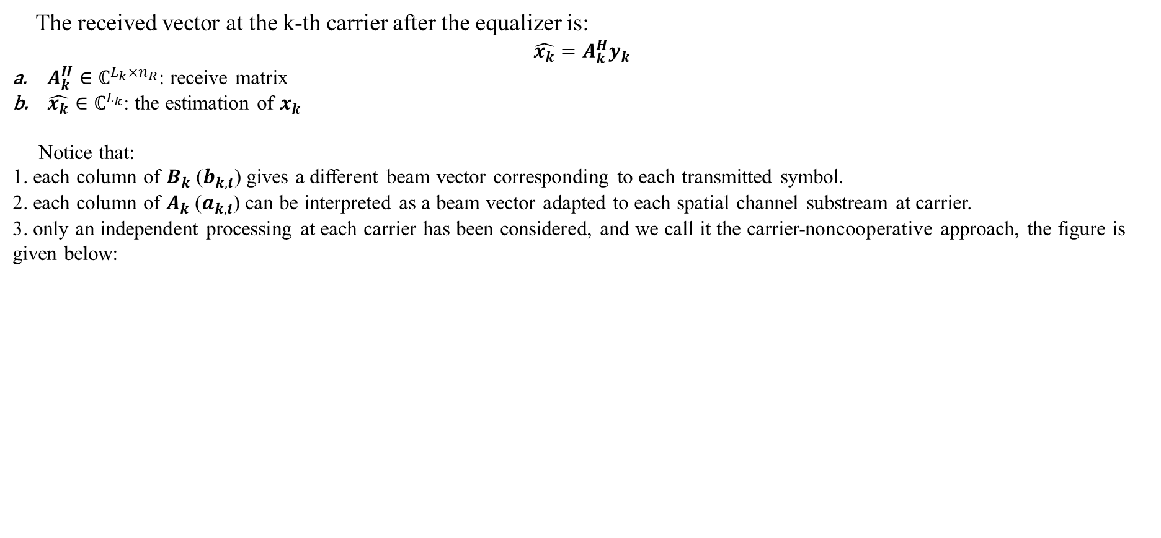
Carrier-noncooperative approach
The received vector at the k-th carrier after the equalizer is:
$$\hat{x_{k}}=A_{k}^{H}y_{k}$$
$A_{k}^{H}∈ℂ^{{L_{k}×n}_{R}}$: receive matrix
$\hat{x_{k}}∈ℂ^{L_{k}}$: the estimation of $x_{k}$
Notice that:
1. each column of $B_{k}$($b_{k,i}$) gives a different beam vector corresponding to each transmitted symbol.
2. each column of $A_{k}$($a_{k,i}$) can be interpreted as a beam vector adapted to each spatial channel substream at carrier.
3. only an independent processing at each carrier has been considered, and we call it the carrier-noncooperative approach, the figure is given below:
independent processing at each carrier: carrier-noncooperative approach

Slide 12
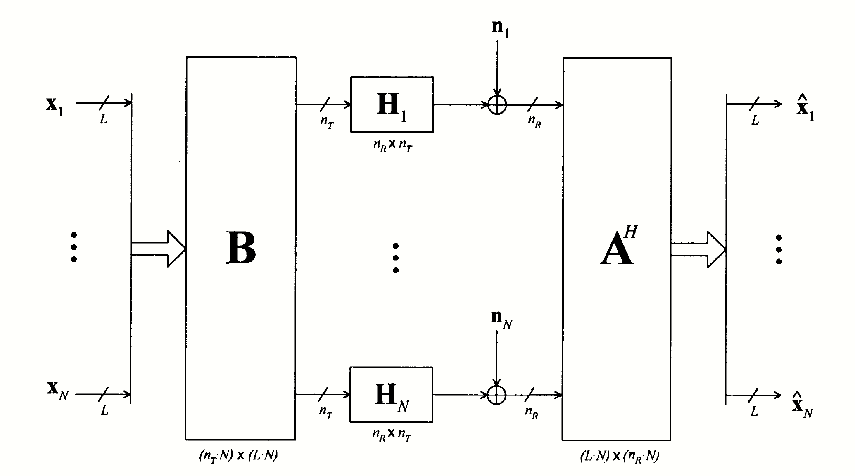
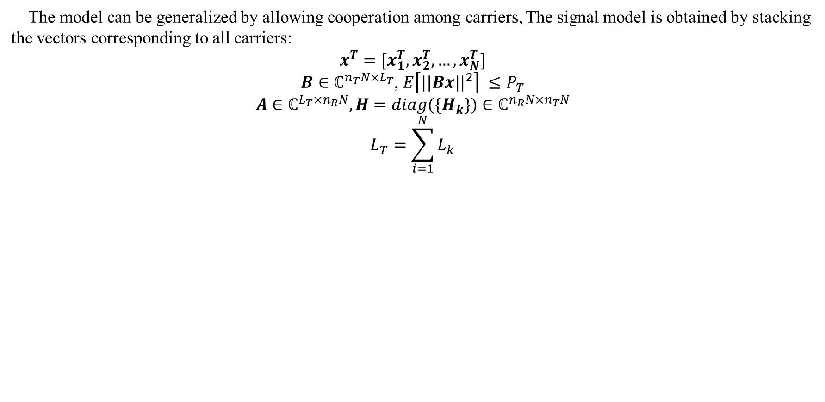
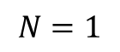
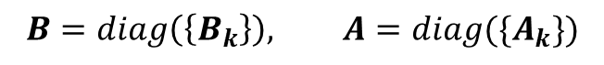
Carrier-cooperative approach
The model can be generalized by allowing cooperation among carriers, The signal model is obtained by stacking the vectors corresponding to all carriers:
$$x^{T}=[x_{1}^{T},x_{2}^{T},…,x_{N}^{T}]$$
$B∈ℂ^{{n_{T}N×L}_{T}}$, $E\left[{||Bx||}^{2}\right] ≤P_{T}$
$A∈ℂ^{{L_{T}×n}_{R}N}, H=diag(\{H_{k}\})$ $∈ℂ^{{n_{R}N×n}_{T}N}$
$$L_{T}=\sum_{i=1}^{N}{L_{k}}$$
Fig. allowing cooperation among carriers: carrier-cooperative approach
$$N=1$$
$$B=diag\left(\left\{B_{k}\right\}\right), A=diag(\{A_{k}\})$$

Slide 13

Optimality of Receive Matrix of the Channel-diagonalizing Structure

Slide 14
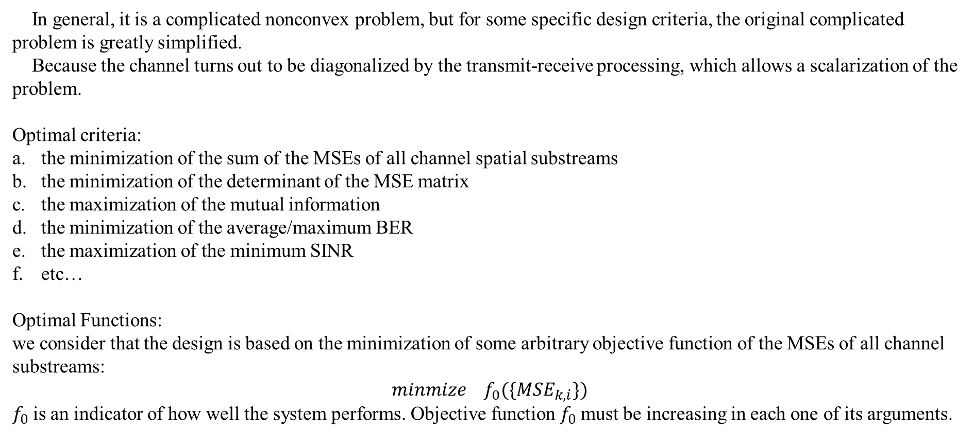
Why a channel-diagonalizing structure?
In general, it is a complicated nonconvex problem, but for some specific design criteria, the original complicated
problem is greatly simplified.
Because the channel turns out to be diagonalized by the transmit-receive processing, which allows a scalarization of the problem.
Optimal criteria:
the minimization of the sum of the MSEs of all channel spatial substreams
the minimization of the determinant of the MSE matrix
the maximization of the mutual information
the minimization of the average/maximum BER
the maximization of the minimum SINR
etc…
Optimal Functions:
we consider that the design is based on the minimization of some arbitrary objective function of the MSEs of all channel substreams:
$$minmize f_{0}(\{{MSE}_{k,i}\})$$
$f_{0}$is an indicator of how well the system performs. Objective function $f_{0}$must be increasing in each one of its arguments.

Slide 15
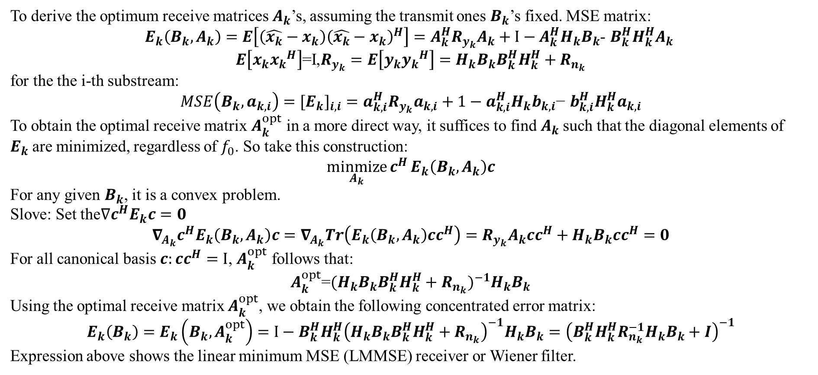
LMMSE Receiver Matrix
To derive the optimum receive matrices $A_{k}$’s, assuming the transmit ones $B_{k}$’s fixed. MSE matrix:
$E_{k}\left(B_{k},A_{k}\right)=E\left[\left(\hat{x_{k}}−x_{k}\right){\left(\hat{x_{k}}−x_{k}\right)}^{H}\right]=A_{k}^{H}R_{y_{k}}A_{k}+I−A_{k}^{H}H_{k}B_{k}$- $B_{k}^{H}H_{k}^{H}A_{k}$
$E\left[x_{k}{x_{k}}^{H}\right]$=I,$R_{y_{k}}=E\left[y_{k}{y_{k}}^{H}\right]=H_{k}B_{k}B_{k}^{H}H_{k}^{H}+R_{n_{k}}$
for the the i-th substream:
$$MSE\left(B_{k},a_{k,i}\right)={{[E}_{k}]}_{i,i}=a_{k,i}^{H}R_{y_{k}}a_{k,i}+1−a_{k,i}^{H}H_{k}b_{k,i}\text{−} b_{k,i}^{H}H_{k}^{H}a_{k,i}$$
To obtain the optimal receive matrix $A_{k}^{opt}$ in a more direct way, it suffices to find $A_{k}$such that the diagonal elements of $E_{k}$are minimized, regardless of $f_{0}$. So take this construction:
$$\underset{A_{k}}{minmize}{c^{H}}E_{k}\left(B_{k},A_{k}\right)c$$
For any given $B_{k}$, it is a convex problem.
Slove: Set the$∇c^{H}E_{k}c=0$
$$∇_{A_{k}}c^{H}E_{k}\left(B_{k},A_{k}\right)c=∇_{A_{k}}Tr\left(E_{k}\left(B_{k},A_{k}\right)cc^{H}\right)=R_{y_{k}}A_{k}cc^{H}+H_{k}B_{k}cc^{H}=0$$
For all canonical basis $c:cc^{H}=I$, $A_{k}^{opt}$ follows that:
$A_{k}^{opt}$=${(H_{k}B_{k}B_{k}^{H}H_{k}^{H}+R_{n_{k}})}^{−1}H_{k}B_{k}$
Using the optimal receive matrix $A_{k}^{opt}$, we obtain the following concentrated error matrix:
$E_{k}\left(B_{k}\right)=E_{k}\left(B_{k},A_{k}^{opt}\right)=$ $I−B_{k}^{H}H_{k}^{H}{\left(H_{k}B_{k}B_{k}^{H}H_{k}^{H}+R_{n_{k}}\right)}^{−1}H_{k}B_{k}={\left(B_{k}^{H}H_{k}^{H}R_{n_{k}}^{−1}H_{k}B_{k}+I\right)}^{−1}$
Expression above shows the linear minimum MSE (LMMSE) receiver or Wiener filter.

Slide 16
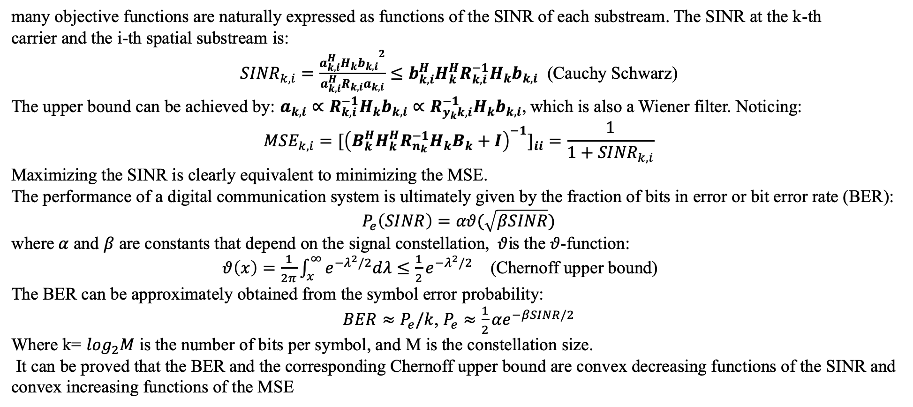
SINR/BER
many objective functions are naturally expressed as functions of the SINR of each substream. The SINR at the k-th
carrier and the i-th spatial substream is:
${SINR}_{k,i}=\frac{{a_{k,i}^{H}H_{k}b_{k,i}}^{2}}{a_{k,i}^{H}R_{k,i}a_{k,i}}≤b_{k,i}^{H}H_{k}^{H}R_{k,i}^{−1}H_{k}b_{k,i}$ (Cauchy Schwarz)
The upper bound can be achieved by: $a_{k,i}∝R_{k,i}^{−1}H_{k}b_{k,i}∝R_{y_{k}k,i}^{−1}H_{k}b_{k,i}$, which is also a Wiener filter. Noticing:
$${MSE}_{k,i}={{[\left(B_{k}^{H}H_{k}^{H}R_{n_{k}}^{−1}H_{k}B_{k}+I\right)}^{−1}]}_{ii}=\frac{1}{1+{SINR}_{k,i}}$$
Maximizing the SINR is clearly equivalent to minimizing the MSE.
The performance of a digital communication system is ultimately given by the fraction of bits in error or bit error rate (BER):
$$P_{e}\left(SINR\right)=αθ(\sqrt{βSINR})$$
where$α$ and $β$ are constants that depend on the signal constellation, $θ$is the$θ$-function: $θ\left(x\right)=\frac{1}{2π}\int_{x}^{∞}{e^{−λ^{2}/2}dλ}≤\frac{1}{2}e^{−λ^{2}/2}$ (Chernoff upper bound)
The BER can be approximately obtained from the symbol error probability:
$BER≈P_{e}/k$, $P_{e}≈\frac{1}{2}{αe}^{−βSINR/2}$
Where k= $\log_{2}M$ is the number of bits per symbol, and M is the constellation size.
It can be proved that the BER and the corresponding Chernoff upper bound are convex decreasing functions of the SINR and convex increasing functions of the MSE

Slide 17
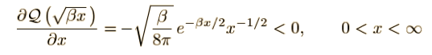
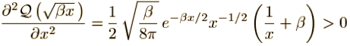
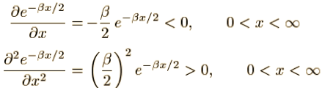
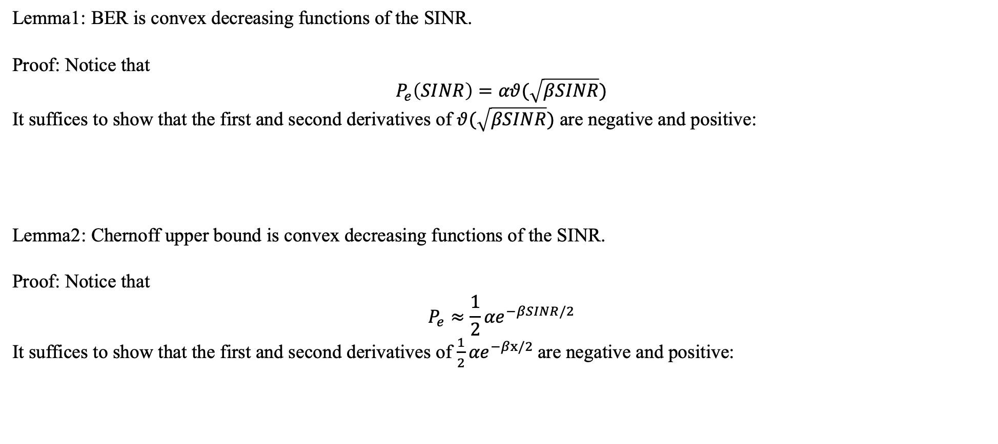
SINR/BER
Lemma1: BER is convex decreasing functions of the SINR.
Proof: Notice that
$$P_{e}\left(SINR\right)=αθ(\sqrt{βSINR})$$
It suffices to show that the first and second derivatives of $θ(\sqrt{βSINR})$ are negative and positive:
Lemma2: Chernoff upper bound is convex decreasing functions of the SINR.
Proof: Notice that
$$P_{e}≈\frac{1}{2}{αe}^{−βSINR/2}$$
It suffices to show that the first and second derivatives of $\frac{1}{2}{αe}^{−βx/2}$are negative and positive:

Slide 18
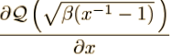
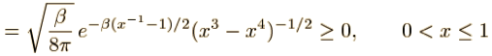
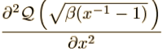
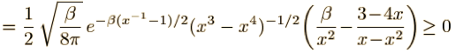
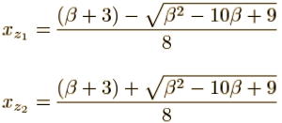
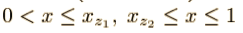
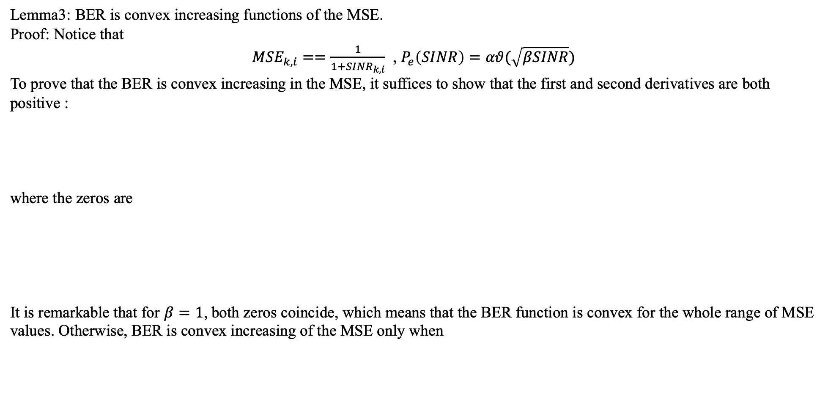
SINR/BER
Lemma3: BER is convex increasing functions of the MSE.
Proof: Notice that
${MSE}_{k,i}==\frac{1}{1+{SINR}_{k,i}}$ , $P_{e}\left(SINR\right)=αθ(\sqrt{βSINR})$
To prove that the BER is convex increasing in the MSE, it suffices to show that the first and second derivatives are both positive :
where the zeros are
It is remarkable that for $β=1$, both zeros coincide, which means that the BER function is convex for the whole range of MSE values. Otherwise, BER is convex increasing of the MSE only when

Slide 19
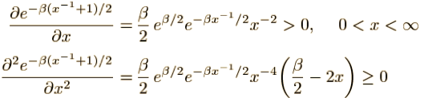
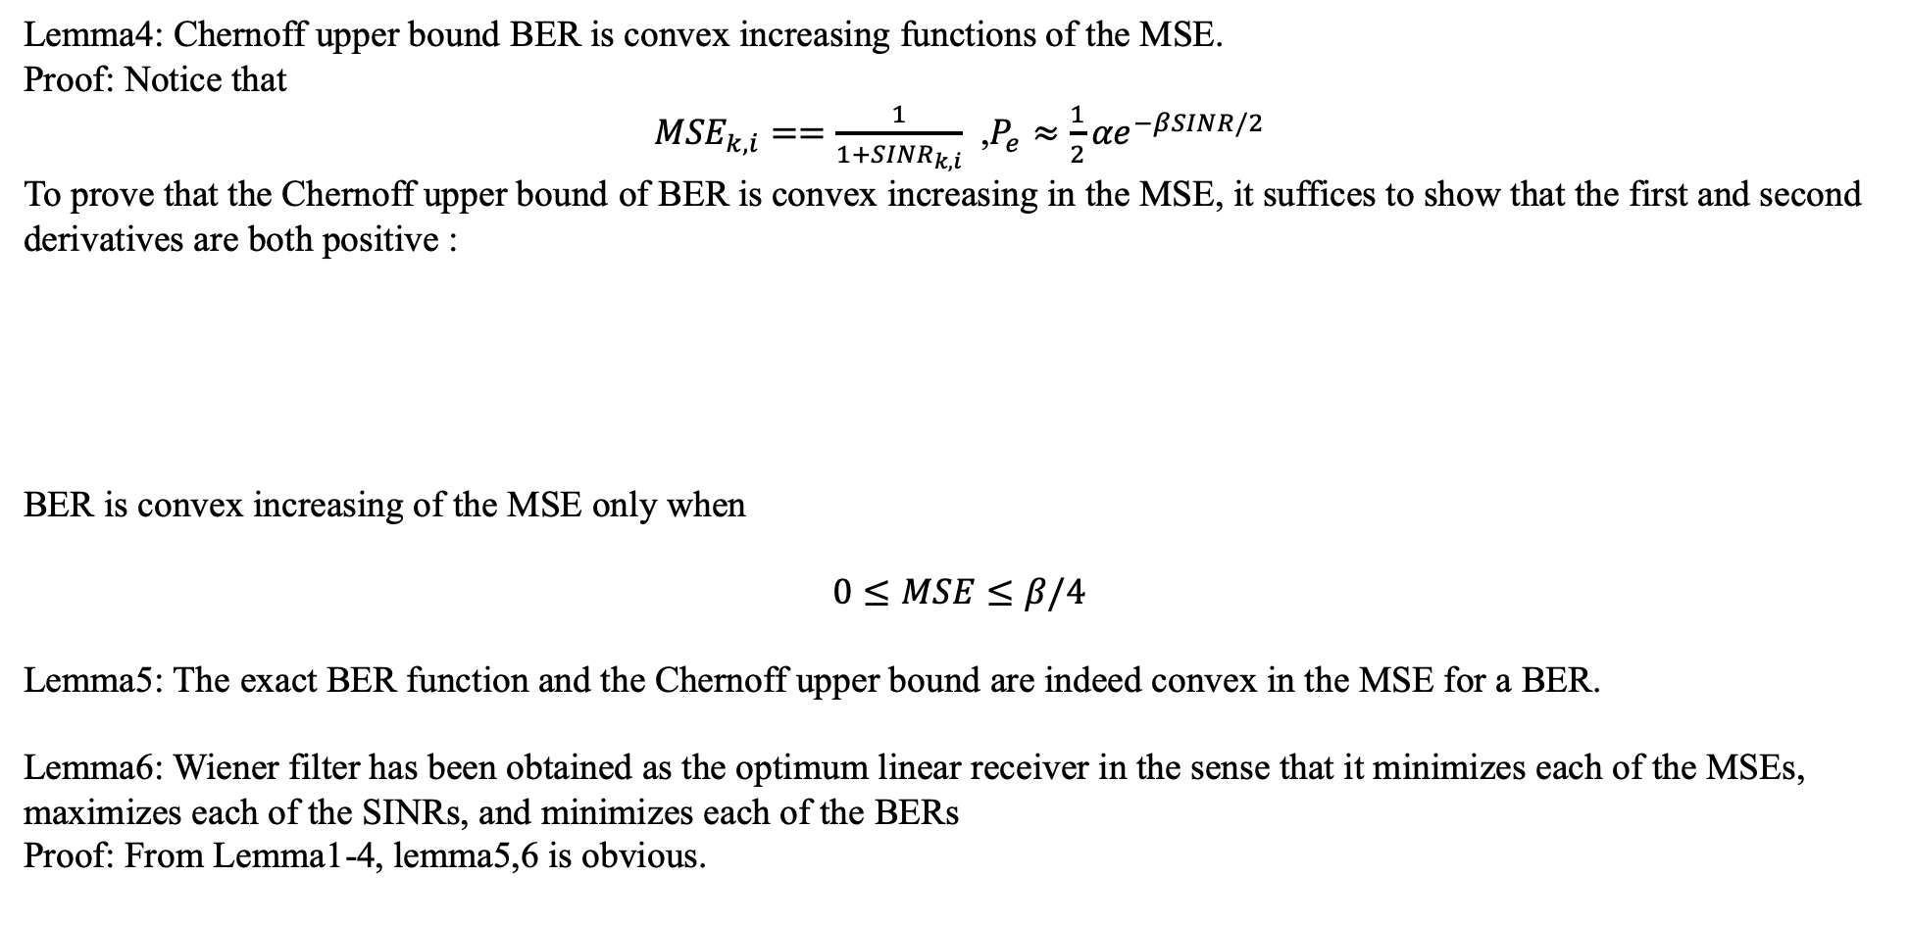
SINR/BER
Lemma4: Chernoff upper bound BER is convex increasing functions of the MSE.
Proof: Notice that
${MSE}_{k,i}==\frac{1}{1+{SINR}_{k,i}}$ ,$P_{e}≈\frac{1}{2}{αe}^{−βSINR/2}$
To prove that the Chernoff upper bound of BER is convex increasing in the MSE, it suffices to show that the first and second derivatives are both positive :
BER is convex increasing of the MSE only when
$$0≤MSE≤β/4$$
Lemma5: The exact BER function and the Chernoff upper bound are indeed convex in the MSE for a BER.
Lemma6: Wiener filter has been obtained as the optimum linear receiver in the sense that it minimizes each of the MSEs, maximizes each of the SINRs, and minimizes each of the BERs
Proof: From Lemma1-4, lemma5,6 is obvious.

Slide 20
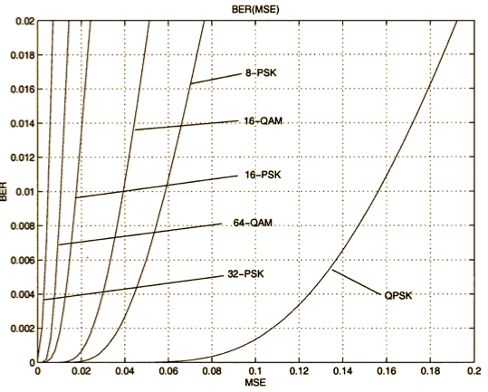
Convexity of the BER as a function of the MSE
Convexity of the BER as a function of the MSE for the range of BER$≤2∗{10}^{−2}$

Slide 21
05
Optimality of Transmit Matrix of the Channel-diagonalizing Structure

Slide 22
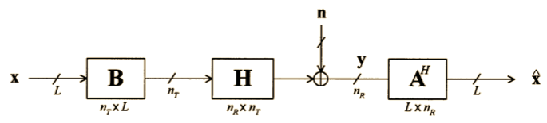
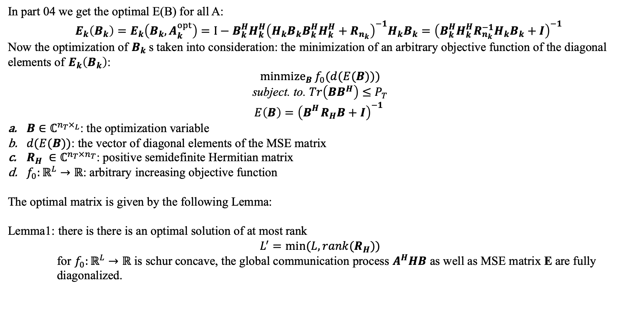
Question described
In part 04 we get the optimal E(B) for all A:
$E_{k}\left(B_{k}\right)=E_{k}\left(B_{k},A_{k}^{opt}\right)=$ $I−B_{k}^{H}H_{k}^{H}{\left(H_{k}B_{k}B_{k}^{H}H_{k}^{H}+R_{n_{k}}\right)}^{−1}H_{k}B_{k}={\left(B_{k}^{H}H_{k}^{H}R_{n_{k}}^{−1}H_{k}B_{k}+I\right)}^{−1}$
Now the optimization of $B_{k}$s taken into consideration: the minimization of an arbitrary objective function of the diagonal elements of $E_{k}\left(B_{k}\right)$:
$\underset{B}{minmize}{f_{0}(d(E(B)))}$
subject. to. $Tr\left(BB^{H}\right)≤P_{T}$
$$E\left(B\right)={\left(B_{}^{H}R_{H}B+I\right)}^{−1}$$
$B∈ℂ^{{n_{T}×}_{L}}$: the optimization variable
$d(E(B))$: the vector of diagonal elements of the MSE matrix
$R_{H} ∈ℂ^{n_{T}×n_{T}}$: positive semidefinite Hermitian matrix
$f_{0}:ℝ^{L}→ℝ$: arbitrary increasing objective function
The optimal matrix is given by the following Lemma:
Lemma1: there is there is an optimal solution of at most rank
$$L^{′}=min⁡(L,rank(R_{H}))$$
for $f_{0}:ℝ^{L}→ℝ$ is schur concave, the global communication process $A^{H}HB$ as well as MSE matrix E are fully diagonalized.

Slide 23
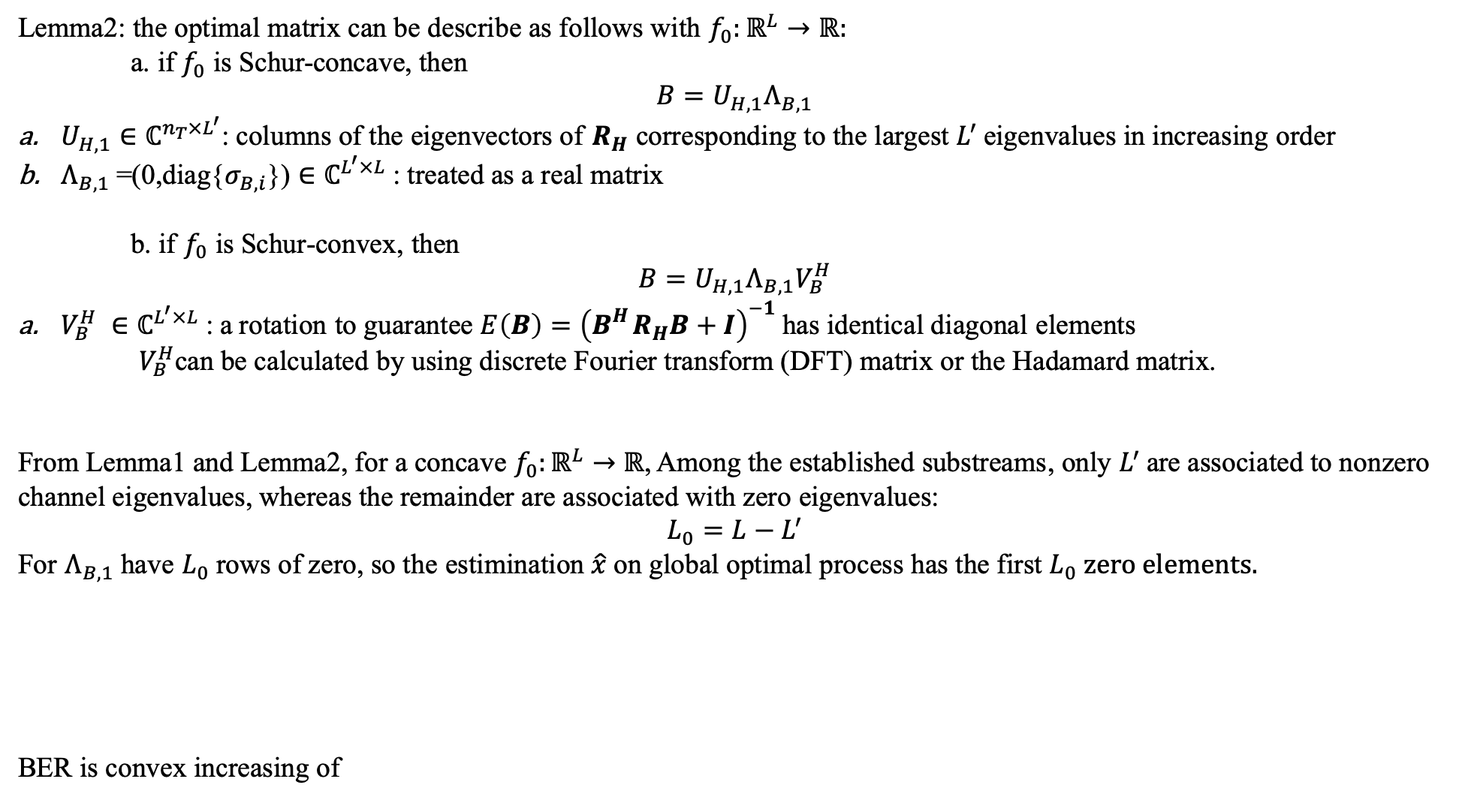
solution
Lemma2: the optimal matrix can be describe as follows with $f_{0}:ℝ^{L}→ℝ:$
a. if $f_{0}$ is Schur-concave, then
$${B=U}_{H,1}Λ_{B,1}$$
$U_{H,1}∈ℂ^{n_{T}×L^{′}}$: columns of the eigenvectors of $R_{H}$ corresponding to the largest $L^{′}$eigenvalues in increasing order
$Λ_{B,1}$=(0,diag{$σ_{B,i}$}) $∈ℂ^{L^{′}×L}$: treated as a real matrix
b. if $f_{0}$ is Schur-convex, then
$${B=U}_{H,1}Λ_{B,1}V_{B}^{H}$$
$V_{B}^{H} ∈ℂ^{L^{′}×L}$: a rotation to guarantee $E\left(B\right)={\left(B_{}^{H}R_{H}B+I\right)}^{−1}$has identical diagonal elements
$V_{B}^{H}$can be calculated by using discrete Fourier transform (DFT) matrix or the Hadamard matrix.
From Lemma1 and Lemma2, for a concave $f_{0}:ℝ^{L}→ℝ$, Among the established substreams, only $L^{′}$are associated to nonzero channel eigenvalues, whereas the remainder are associated with zero eigenvalues:
$$L_{0}=L−L^{′}$$
For $Λ_{B,1}$ have $L_{0}$ rows of zero, so the estimination $\hat{x}$on global optimal process has the first $L_{0} zero elements.$
BER is convex increasing of

Slide 24
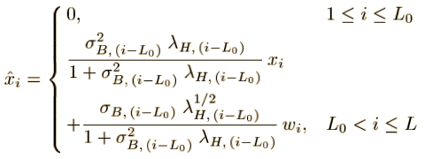
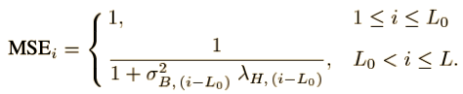
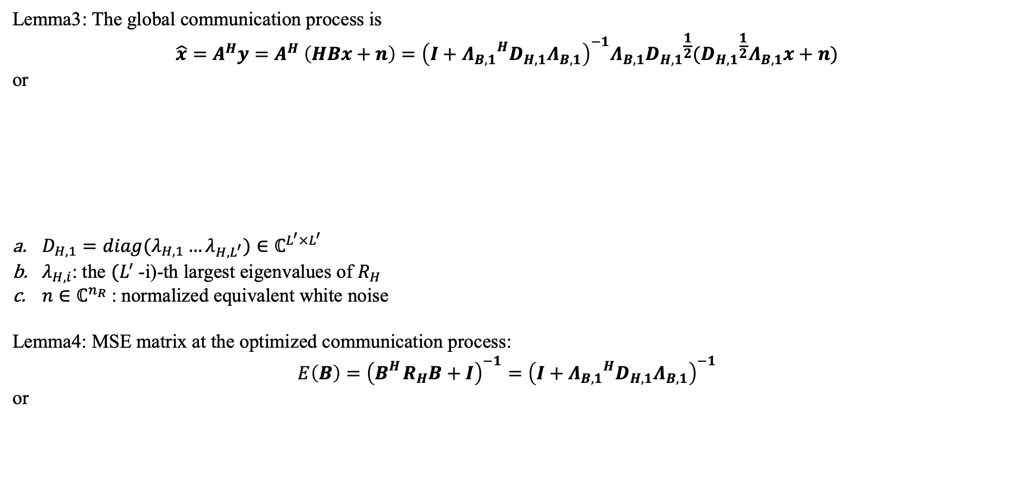
solution
Lemma3: The global communication process is
$$\hat{x}=A^{H}y=A^{H} \left(HBx+n\right)={\left(I+{Λ_{B,1}}^{H}D_{H,1}Λ_{B,1}\right)}^{−1}Λ_{B,1}{D_{H,1}}^{\frac{1}{2}}({D_{H,1}}^{\frac{1}{2}}Λ_{B,1}x+n)$$
or
$D_{H,1}=diag(λ_{H,1}…λ_{H,L^{′}})∈ℂ^{L^{′}×L^{′}}$
$λ_{H,i}$: the $(L^{′}$-i)-th largest eigenvalues of $R_{H}$
$n∈ℂ^{n_{R}}$: normalized equivalent white noise
Lemma4: MSE matrix at the optimized communication process:
$$E\left(B\right)={\left(B_{}^{H}R_{H}B+I\right)}^{−1}={\left(I+{Λ_{B,1}}^{H}D_{H,1}Λ_{B,1}\right)}^{−1}$$
or

Slide 25
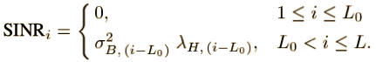


solution
Lemma5: SNRs at the optimized communication process:
$${MSE}_{i}={{[\left(B_{}^{H}R_{H}B+I\right)}^{−1}]}_{ii}=\frac{1}{1+{SINR}_{i}}$$
or
Therefore, if
L>rank($R_{H}$)$→L^{′}=\text{rank}\text{(}R_{H}\text{)}→L_{0}>0$
the $L_{0}$substreams associated with zero eigenvalues have an MSE equal to 1 or a zero SINR (which implies a BER equal to 0.5). So generally a Schur-concave function communication system should guarantee that
L$≤$rank($R_{H}$)
The figure shows the optimized system:

Slide 26



solution
Lemma3-5 are the results of a Schur-concave $f_{0}$
For a Schur-convex $f_{0}$, the MSE matrix E is nondiagonal with equal diagonal elements, while $A^{H}HB$ can be diagonalized only up to a very specific rotation of the data symbols.
Here we assume a pre-rotation of the data symbols at the transmitter and a post-rotation of the estimates at the receiver:
$$\check{x}=V_{B}^{H}x$$
$$\check{\hat{x}}=V_{B}^{H}\hat{x}$$
And Schur concave results can be used as MSE matrix $E={\left(B_{}^{H}R_{H}B+I\right)}^{−1}$are equal whenever the appropriate rotation is included
${MSE}_{i}=\frac{Tr(E)}{L}$
According to
$${MSE}_{i}={{[\left(B_{}^{H}R_{H}B+I\right)}^{−1}]}_{ii}=\frac{1}{1+{SINR}_{i}}$$
the SINRs are given:

Slide 27


solution
Conclusion of a single carrier:
For Schur-concave functions, the specific power distribution among the established substreams will depend on the particular objective function $f_{0}$. Interestingly.
For Schur-convex functions, the power distribution is independent of the specific choice of $f_{0}$ since both the MSE expression and the rotation matrix to make the diagonal elements of the MSE matrix equal are independent of $f_{0}$
How to deal with a multicarrier case?
For any carrier , consider the matrices corresponding to the rest of the carriers ${(B_{l})}_{l≠k}$fixed, and Theorem above can be directly involved to show the optimal structure for $B_{k}$.

Slide 28
06
Joint TX-RX Beamforming Design

Slide 29

Question described
In part 04&05 we get the optimal for all A,B:
$E_{k}\left(B_{k}\right)=E_{k}\left(B_{k},A_{k}^{opt}\right)=$ $I−B_{k}^{H}H_{k}^{H}{\left(H_{k}B_{k}B_{k}^{H}H_{k}^{H}+R_{n_{k}}\right)}^{−1}H_{k}B_{k}={\left(B_{k}^{H}H_{k}^{H}R_{n_{k}}^{−1}H_{k}B_{k}+I\right)}^{−1}$
Now the Optimal criteria:
the minimization of the sum of the MSEs of all channel spatial substreams
the minimization of the determinant of the MSE matrix
the maximization of the mutual information
the minimization of the average/maximum BER
the maximization of the minimum SINR
is specified in practical.

Slide 30



Question described
1. The minimization of the (weighted) arithmetic mean of the MSEs (ARITH-MSE) :
The objective function is
Lemma1: The function is minimized when the weights are in increasing order , and it is then a Schur-concave function.
The problem in convex form (the objective is convex and the constraints linear):
the solution
the solution has a nice water-filling interpretation.

Slide 31



Question described
2. the minimization of the weighted geometric mean of the MSEs (GEOM-MSE) :
The objective function is
Lemma2: The function is minimized when the weights are in increasing order , and it is then a Schur-concave function on each carrier k.
The problem in convex form (the objective is convex and the constraints linear):
the solution

Slide 32



Question described
3. minimize the maximum of the MSEs (MAX-MSE) :
The objective function is
Lemma3: The function is a Schur-convex function.
The problem in convex form (the objective is linear and the constraints convex):
the solution

Slide 33



Question described
4. minimized for the maximization of the (weighted) arithmetic mean of the SINRs (ARITH-SINR) :
The objective function is
It can be expressed as a function of MSEs:
Lemma4: The function is minimized when the weights are in increasing order , and it is then a Schur-concave function.
The problem in convex form (the objective is linear and the constraints convex):
Solutions is to allocate all the available power to the substream with maximum weighted gain, which has extremely poor spectral efficiency.
the solution

Slide 34




Question described
5. minimized for the maximization of the (weighted) geometric mean of the SINRs (GEOM-SINR) :
The objective function is
It can be expressed as a function of MSEs:
Lemma5: The function is minimized when the weights are in increasing order , and it is then a Schur-concave function.
The problem in convex form (the objective is linear and the constraints convex):
Solutions is :

Slide 35




Question described
6. maximization of the harmonic mean of the SINRs (HARM-SINR) :
The objective function is
It can be expressed as a function of MSEs:
Lemma6: The function is a Schur-convex function.
The problem in convex form (the objective is linear and the constraints convex):
Solutions is :

Slide 36

谢谢
Contact me at
jaylencheng@outlook.com
jaylencheng@ieee.org
jaylencheng.github.io

